Slide 1
ESA L4: Moons of the Giant Planets
it will be cold, dark and far away from home
Space Passive Components Days 2024
ESTEC, 16th of October 2024
Sven Wittig, L4 Technology Coordinator

Slide 2
ESA Science Programme - Fundamentals
The Programme is science-driven
both long-term science planning and mission calls are bottom-up processes, relying on broad scientific community input and peer review
The Programme is mandatory
All Member States contribute pro-rata to GNP providing budget stability and allowing long-term planning of its scientific goals
The Programme includes direct contributions from the Member States
Member States often contribute to the science payload and science ground segment

Slide 3
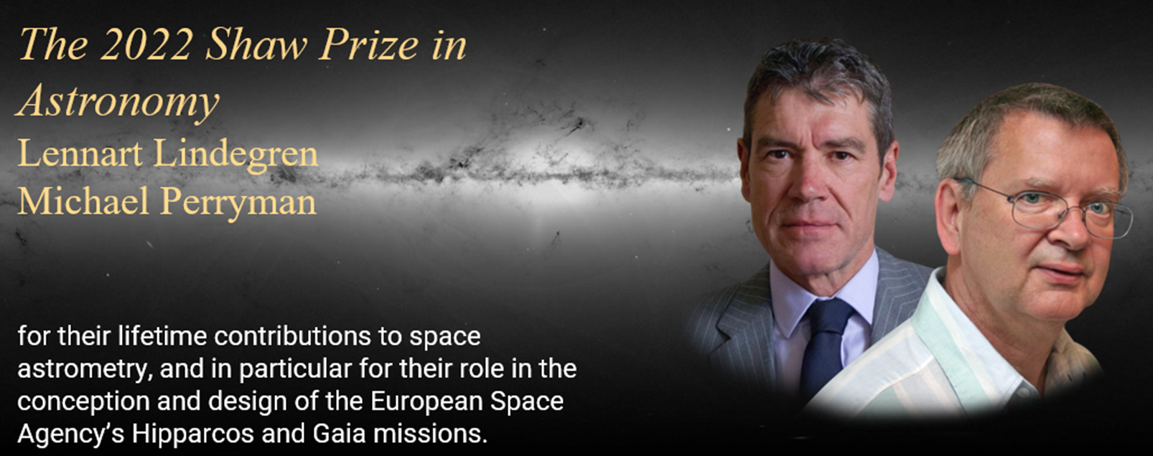
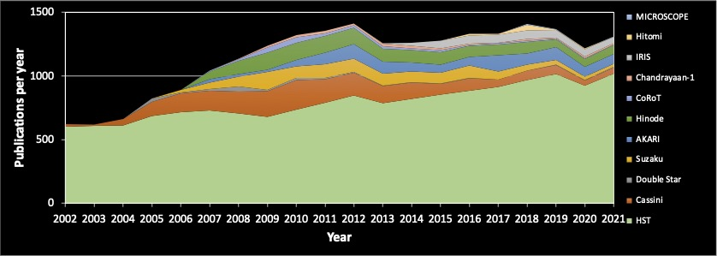
A Highly Visible Programme: ESA Science Refereed Publications
Most papers ever in 2019-2022 (>3500)
About half of these were from Gaia
Strong positive trend with doubling time ~8yr
Pandemic caused some slow-down, but has recovered
~11% of worldwide “market share”, including all ground based and theoretical astrophysics (15% including partner missions).
Citation impact strongly increasing.
CHEOPS
Gaia
Planck
Herschel
Rosetta
MEX
Integral
Cluster
XMM-Newton
ESA-led
Hubble
Partner-led
SOHO

Slide 4
The Science Programme Elements
Science is part of the Mandatory Activities of ESA
Science Programme yearly budget ~632 M€ in 2024
Science Programme missions are proposed by the European scientific community and selected in a competitive process
Four types of missions (building blocks):
Large missions (~1.2 B€, European-led flagships, ~every 7-8y)
Medium missions (~0.6 B€, ~every 3-4y)
Smaller mission elements
Missions of Opportunity

Slide 5
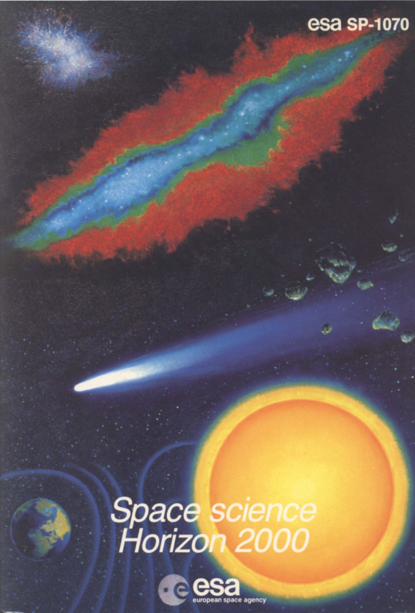
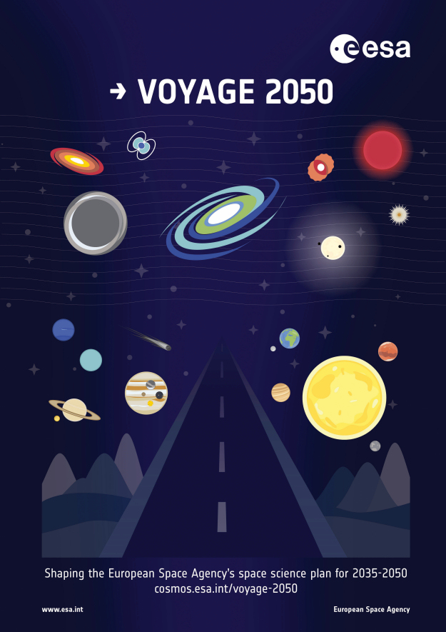
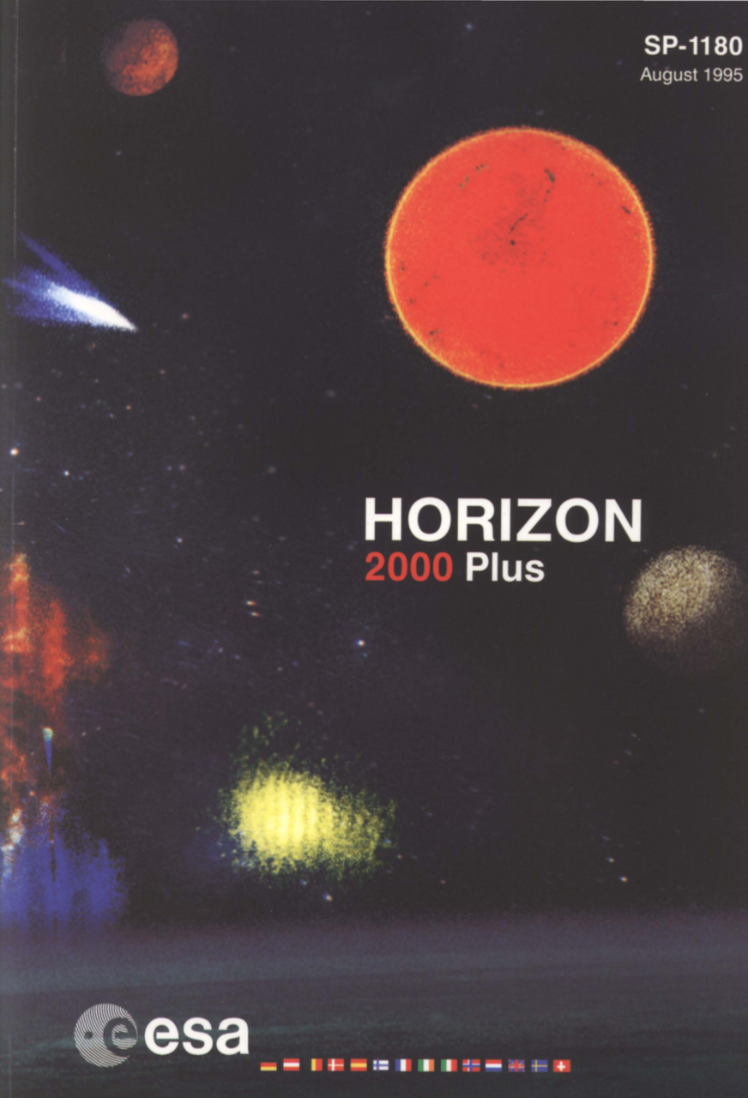
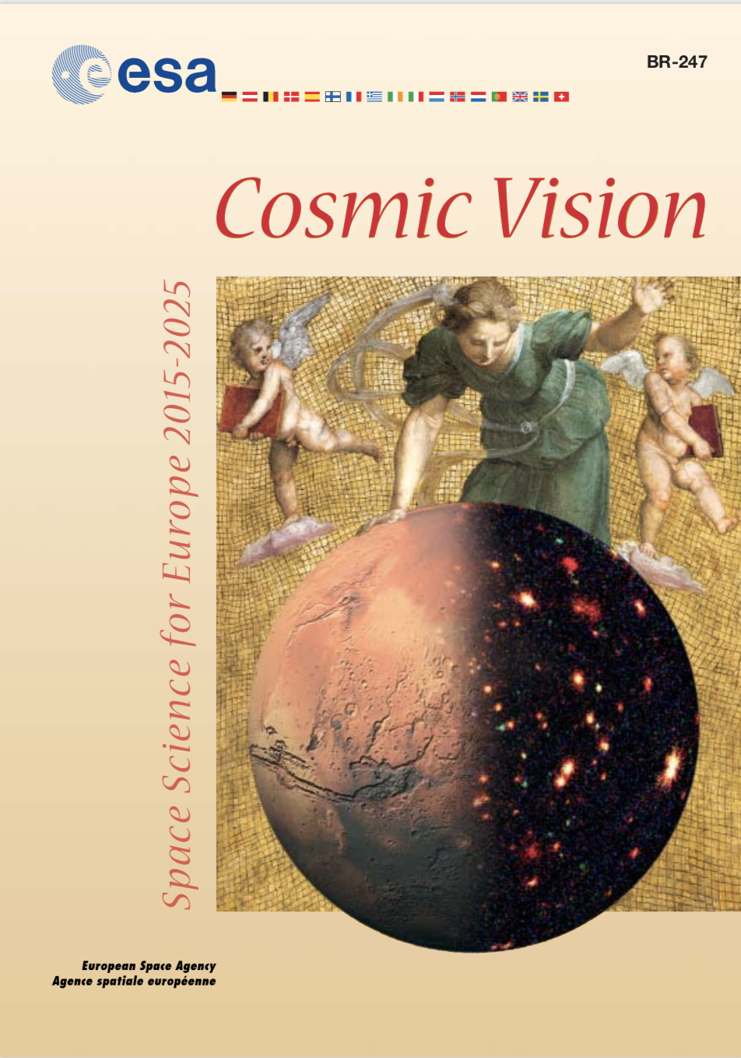
ESA Science Programme – Strategic Planning
Cornerstone missions: SOHO Cluster/Cluster II XMM-Newton Rosetta Herschel
Medium-sized missions: Huygens (Cassini) INTEGRAL Planck
Gaia LISA Pathfinder BepiColombo
1984
L-class missions: JUICE [L1] Athena [L2] LISA [L3]
M-class missions: Solar Orbiter [M1] Euclid [M2]; PLATO [M3] ARIEL [M4]; EnVision [M5]
S/F-class missions: CHEOPS [S1] Comet Interceptor [F1]
ESA-CAS mission: SMILE
1995
2021
2005

Slide 6
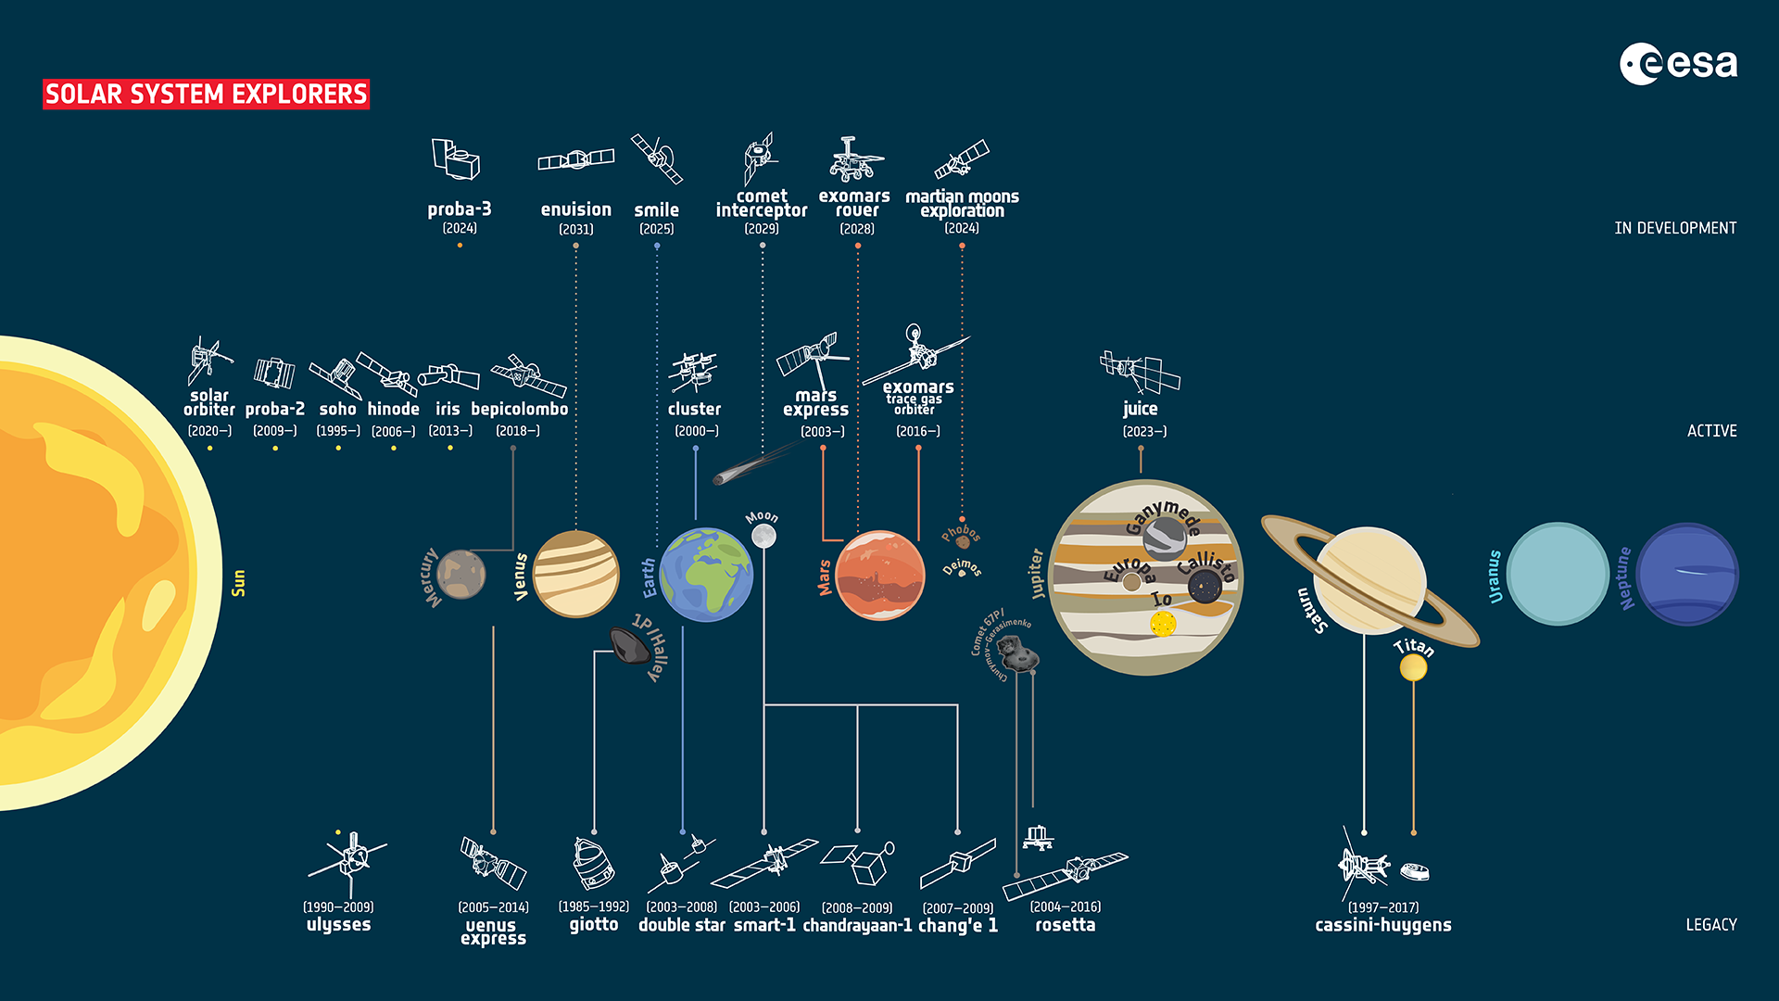

Slide 7
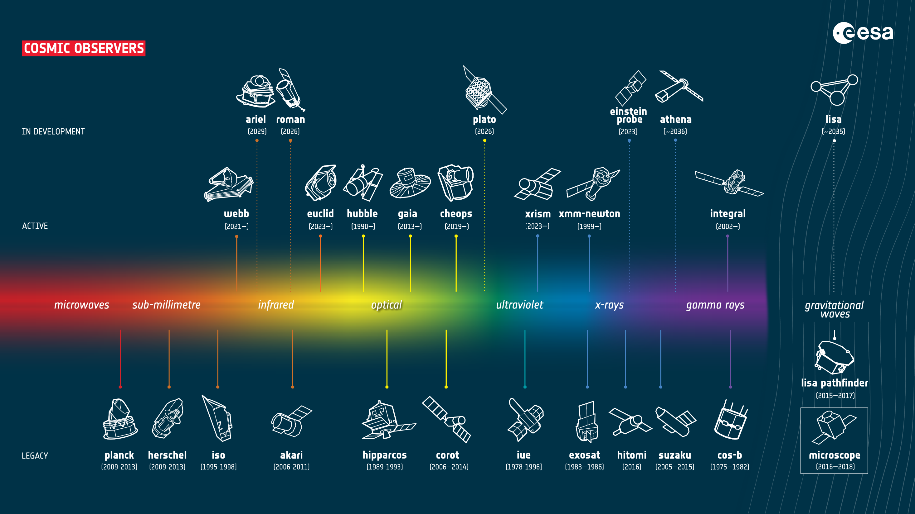

Slide 8
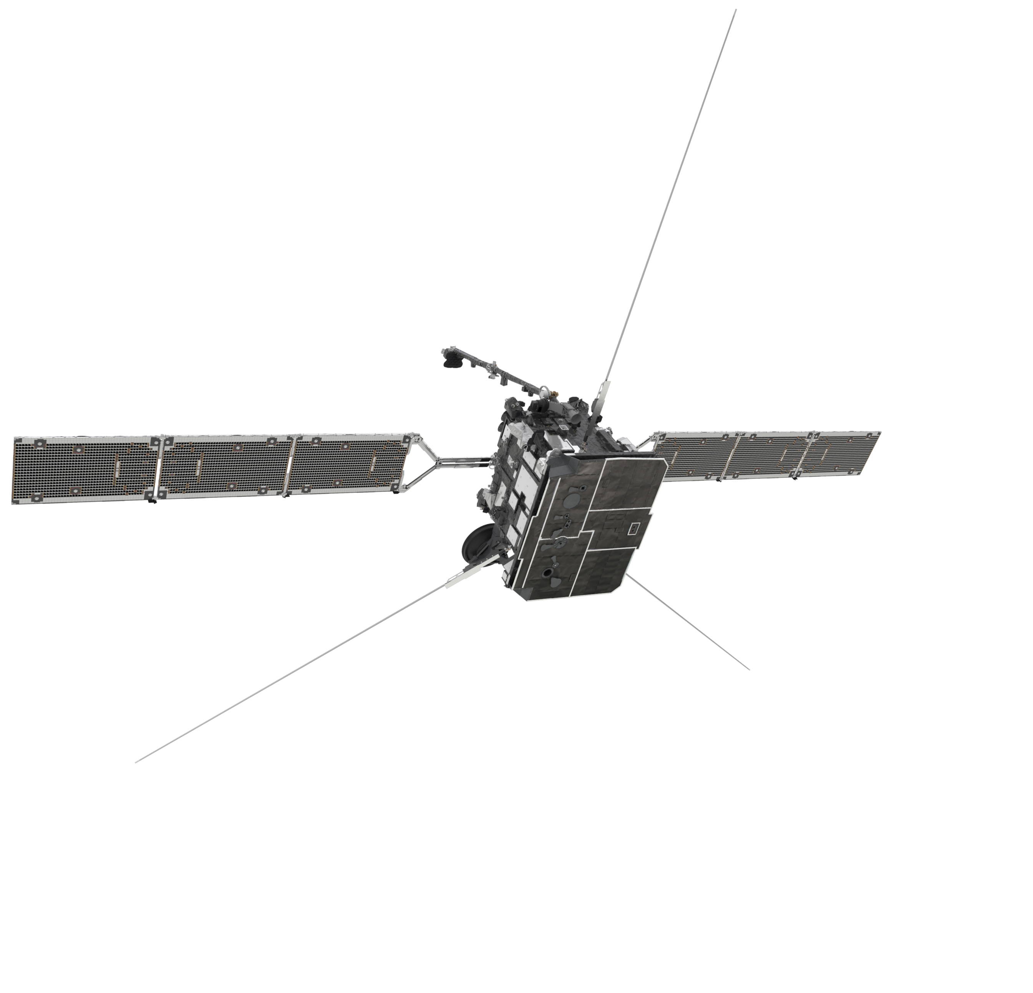
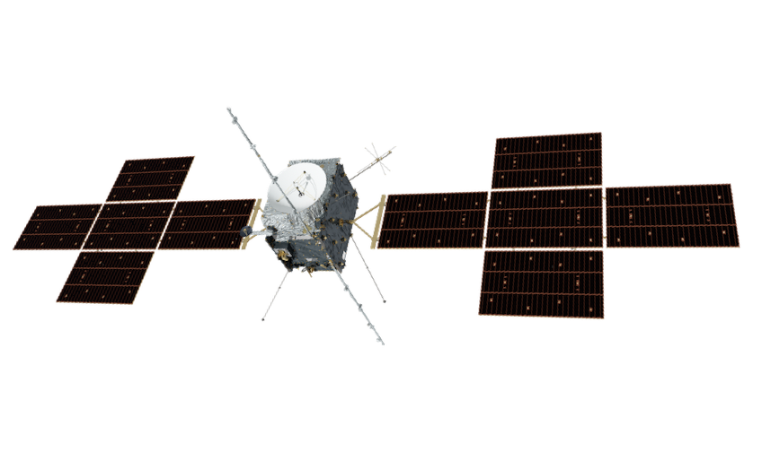
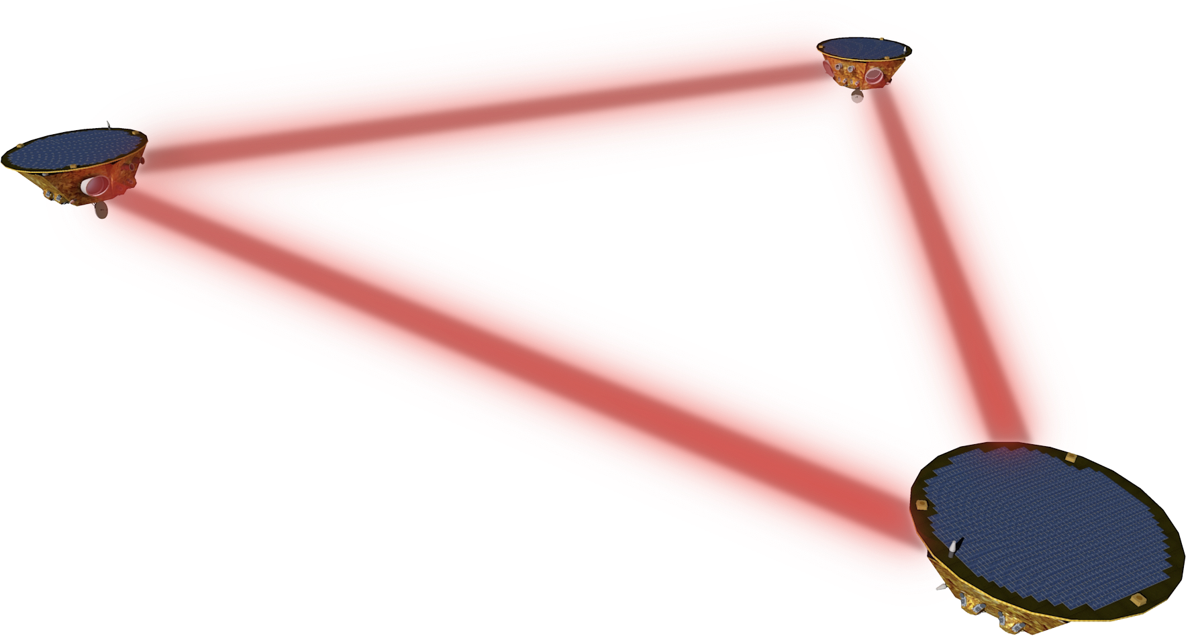
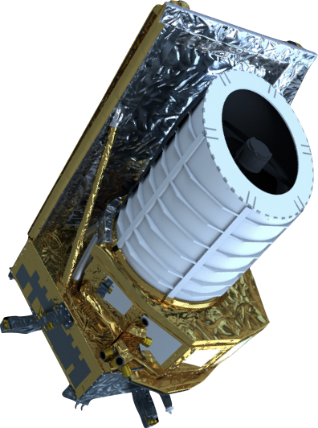
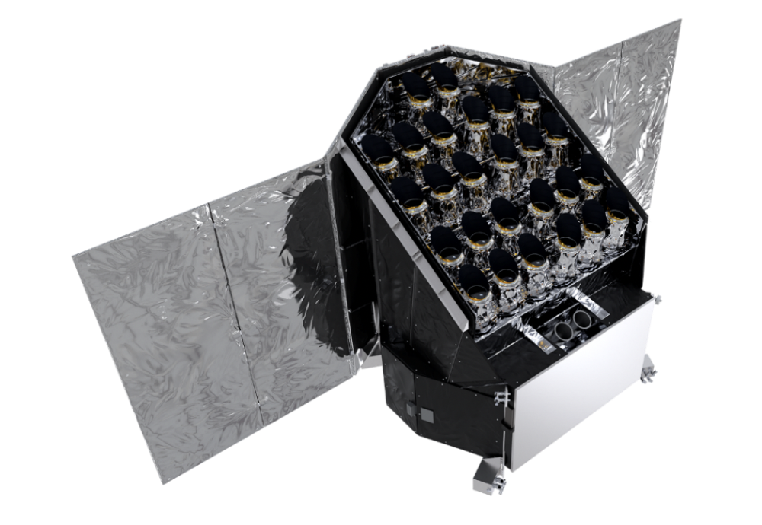
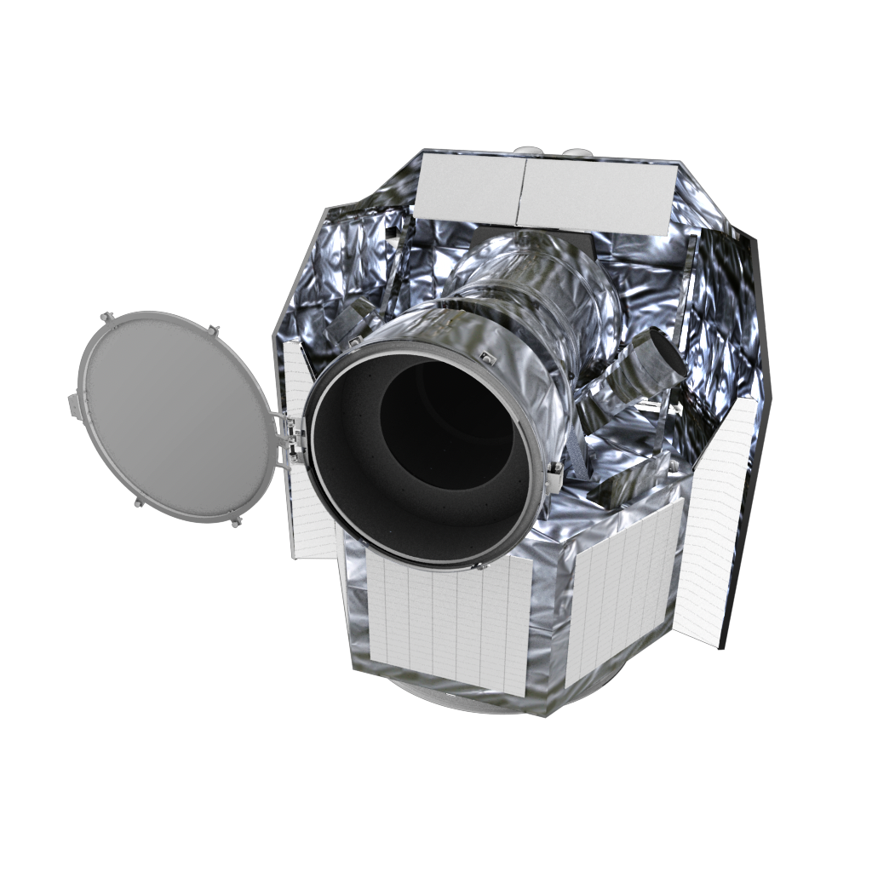
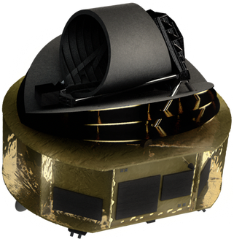
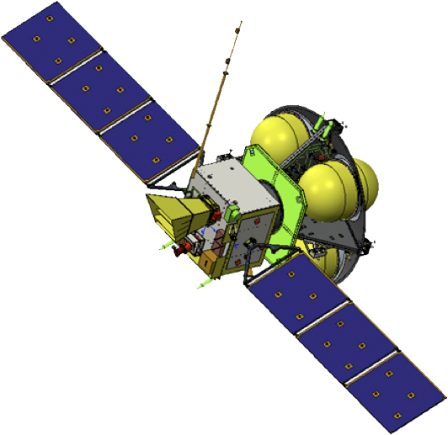
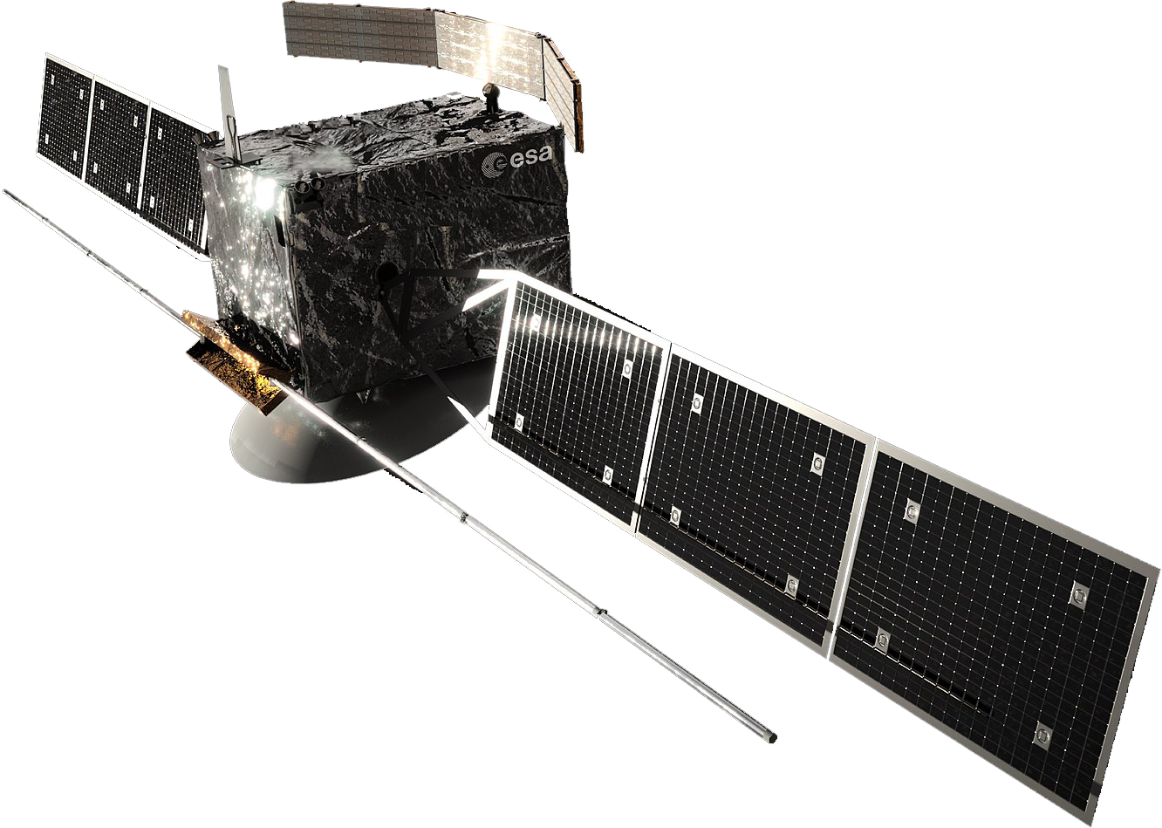
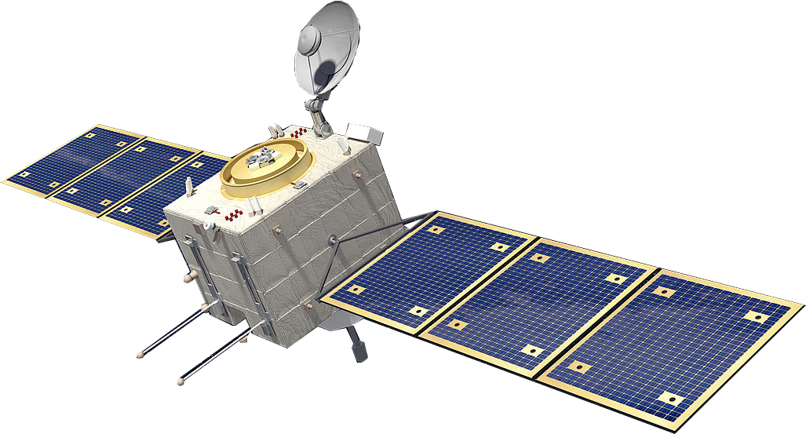
ESA Science: Delivering Missions, Driving Technology
Medium-class
Missions
Launched
14 Apr 2023
Large-class
Missions
L1: JUICE
[2023]
Adopted
Nov 2023
Endorsed
Nov2023
M1: Solar Orbiter
[2020]
L3: LISA
[Mid 2030s]
M2: Euclid
[2023]
L2: NewAthena
[Mid 2030s]
M3: PLATO
[2026]
Adopted
Nov 2023
S1: CHEOPS
[2019]
Small and
Fast Missions
SMILE
[2024]
M4: Ariel
[2029]
M5: EnVision
[early 2030s]
F1: Comet Interceptor
[2029]
F2: ARRAKIHS

Slide 9
The Science Technology Development Plan (TDP)
Developing technology maturity for Science missions for mission implementation
Technical excellence required: European industry developing technology with significant commercial impact
Technology Development Plan elaborated regularly following established procedures, employing the TECNET process
D/SCI is combining in its TECNETs (mostly April/September)
the decision on CTP (~20M€/y) and TDE (~6M€/y) funded TDAs.
A single Technology Plan (updated once or twice per year) is produced, which covers all activities (CTP&TDE) relevant for SCI future mission preparations.
Science Technology Work Plans, once approved by IPC, are made public (Google: "ESA Science Technology Plan”)

Slide 10
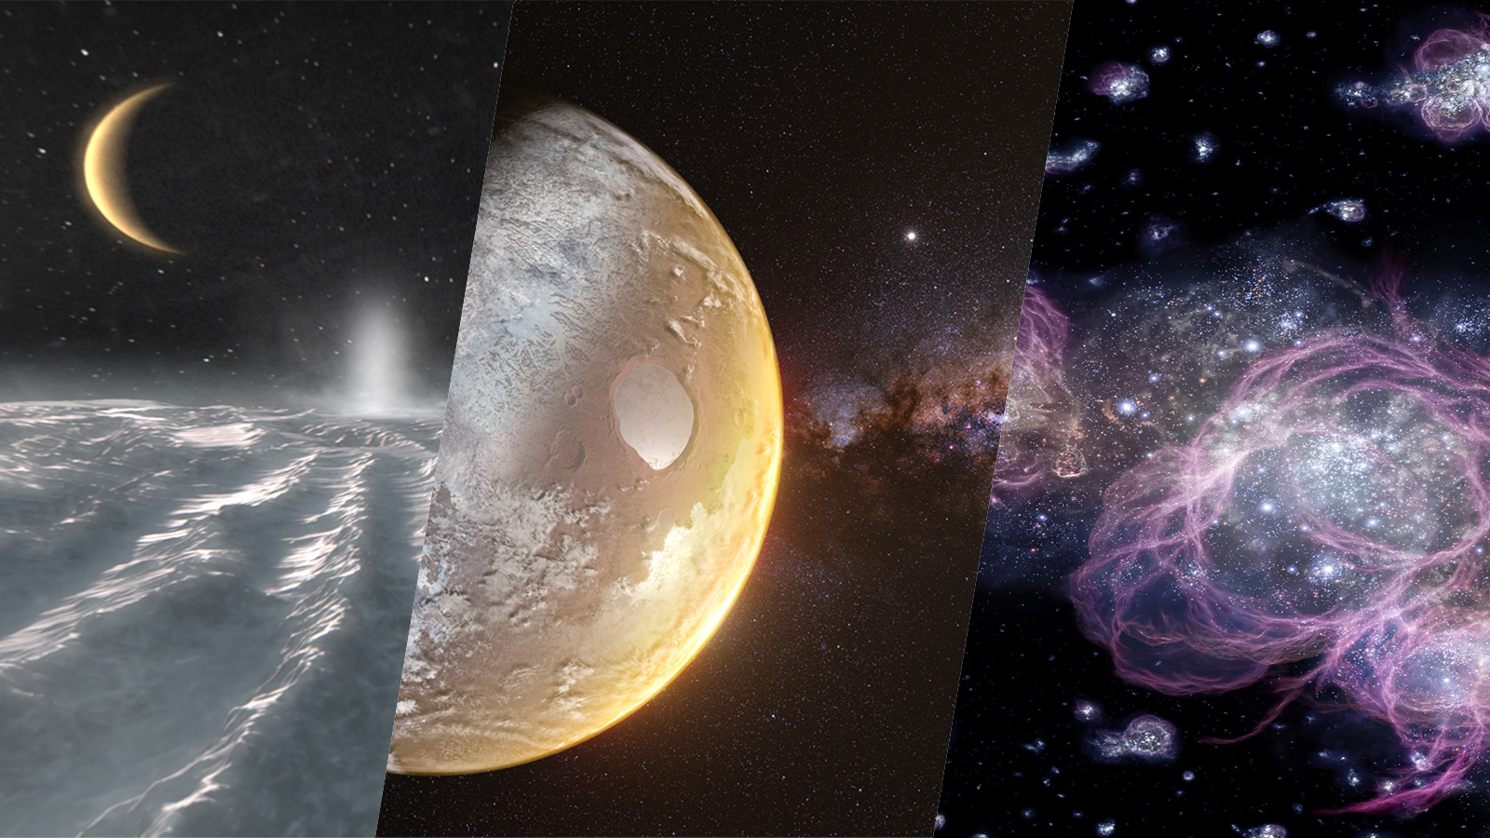
Voyage 2050 Large Mission Science Themes
L4: Moons of the
giant planets
From temperate
exoplanets to the
Milky Way
New physical probes
of the early Universe
Possible Technology Developments:
X-ray interferometry, cold atom interferometry, cryogenic sample return, new propulsion systems to reach
high heliospheric latitudes, new heat and power sources
Notes:
L5
Characterisation of the Atmosphere of Temperate Exoplanets
The Galactic Ecosystem with Astrometry in the Near-infrared
L6
Precision Spectroscopy of the Fireball Universe (CMB)
Adding Colour and Depth to the Gravitational Wave Sky

Slide 11
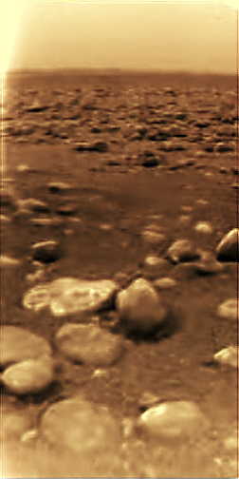
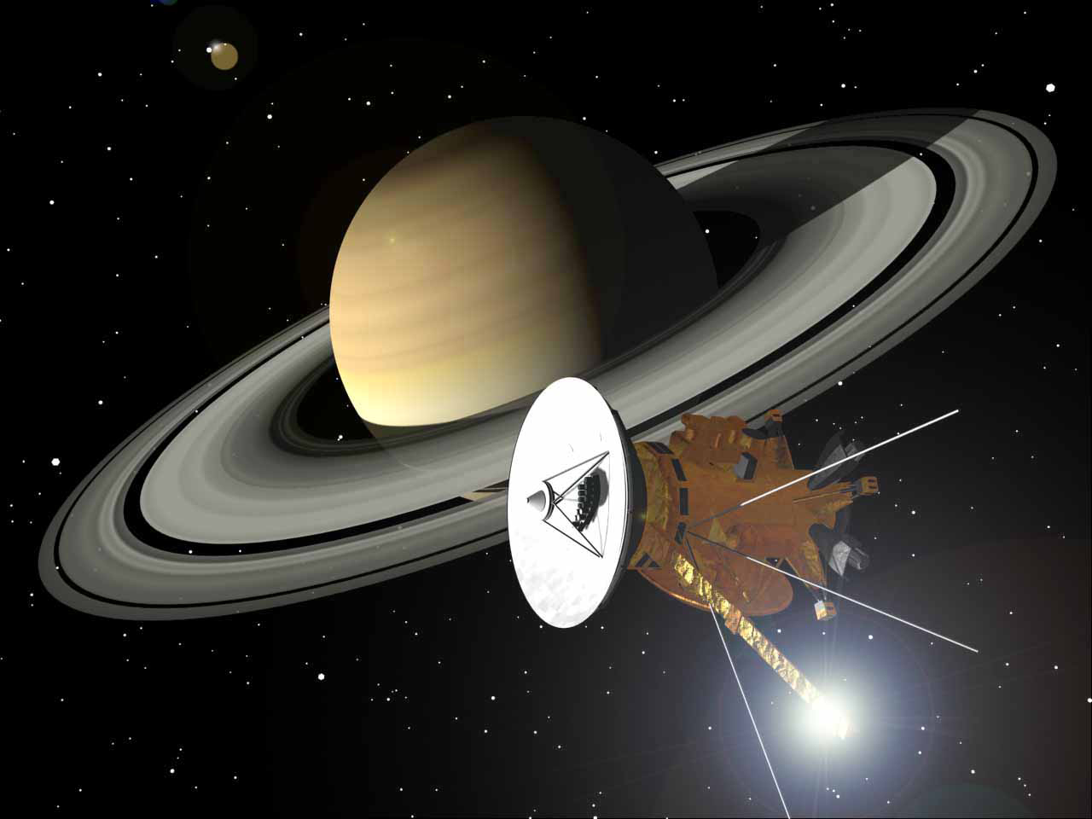
Cassini- Huygens
Credit: Cassini, NASA/JPL/Space Science Institute
Notes:
The Cassini-Huygens was cooperative project between NASA and ESA (and the Italian Space Agency, ASI) which launched in 1997. NASA supplied the main spacecraft, the orbiter Cassini, and ESA supplied the lander, Huygens. In 2005 the Huygens probe descended into the atmosphere of Titan, Saturn's largest moon.

Slide 13
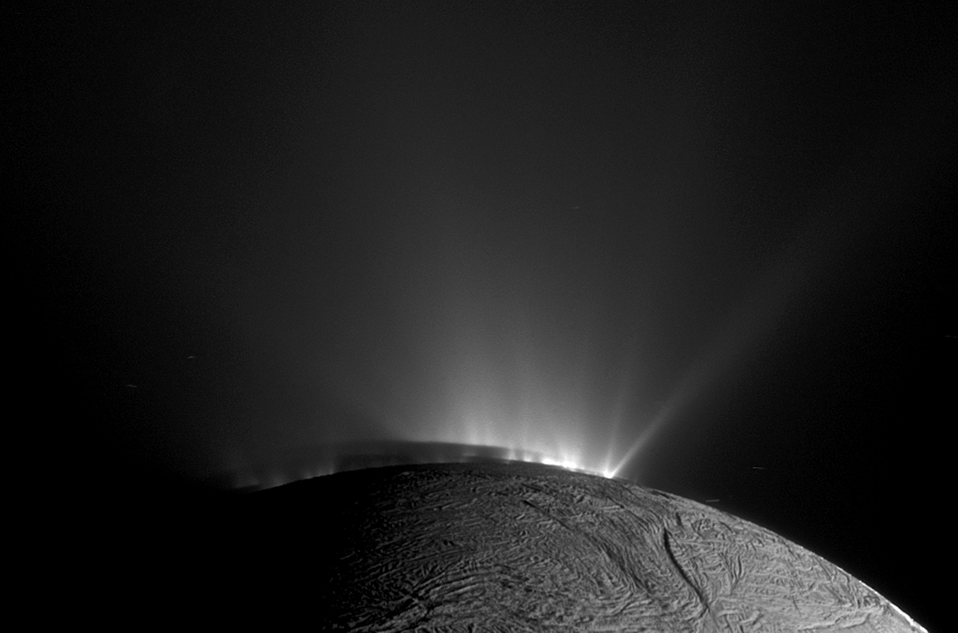
Credit: Cassini, NASA/JPL/Space Science Institute

Slide 14
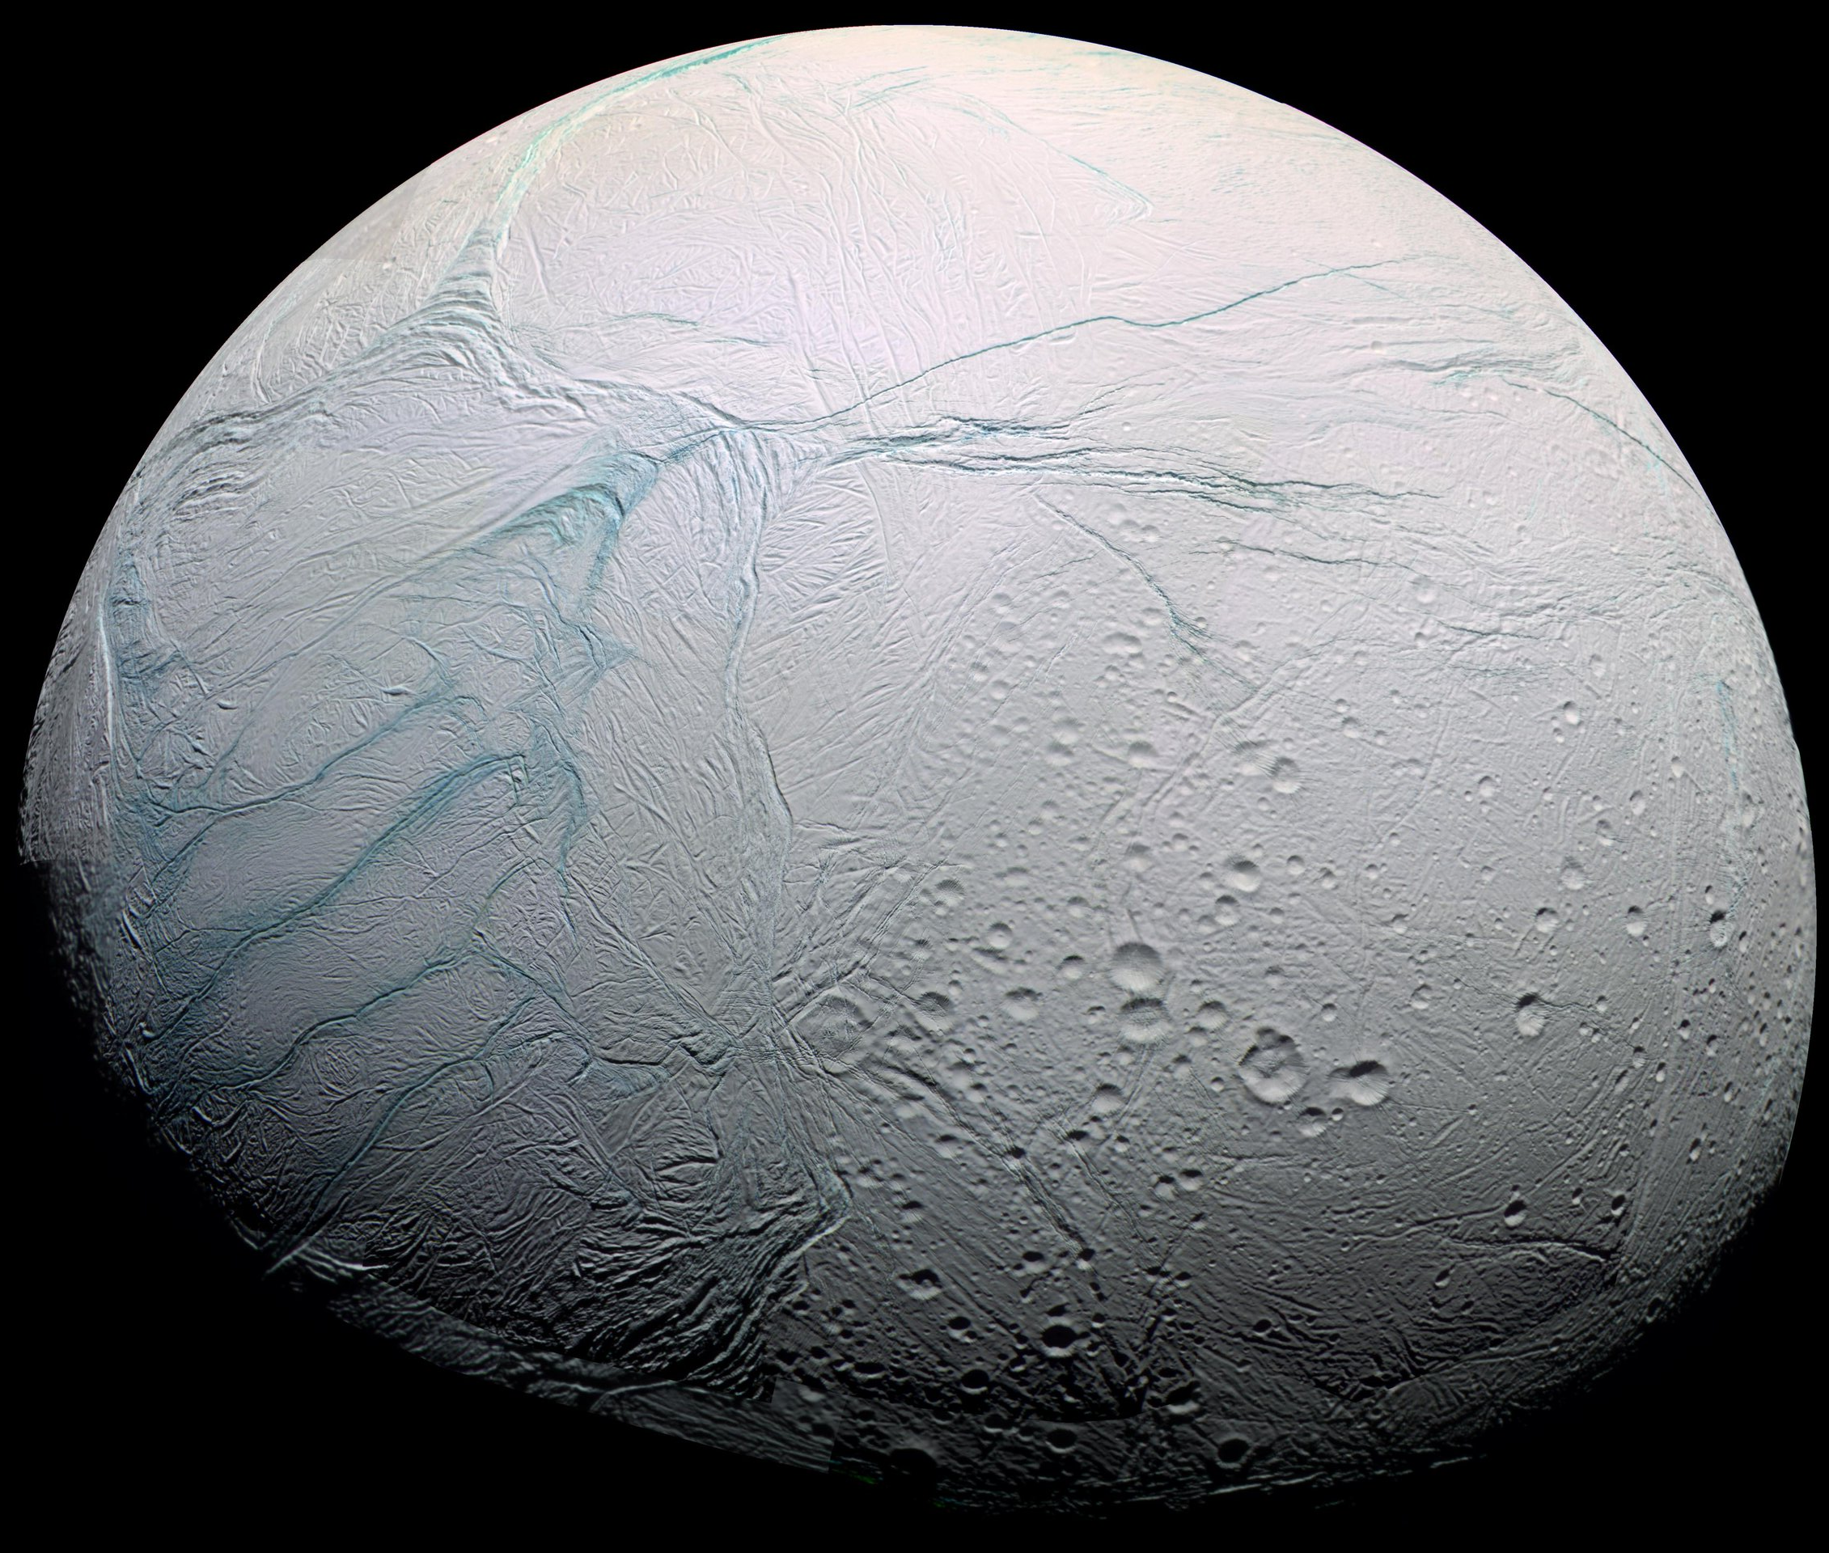
Credit: Cassini, NASA/JPL/Space Science Institute

Slide 15
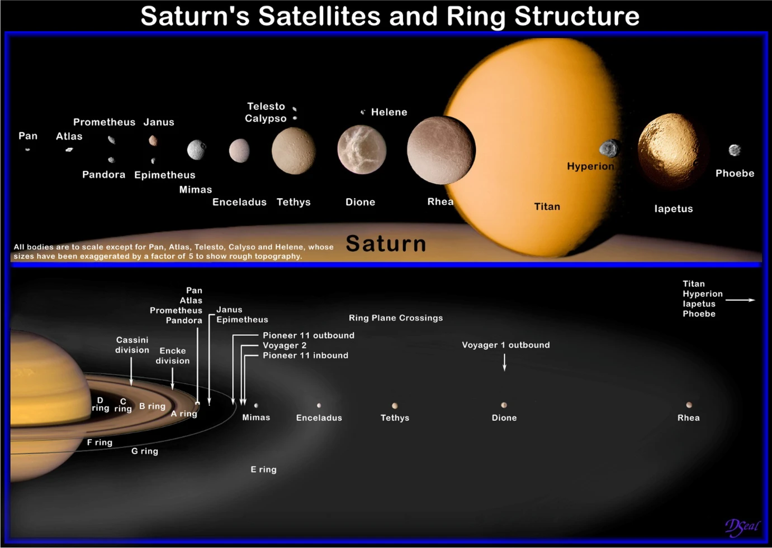
Science Motivation
An independent L4 Science Expert Group has been set up to provide scientific advice for the activities related to the first Large mission of the Voyage 2050 Programme.
The group has confirmed that out of the many moons orbiting around Saturn, Enceladus and Titan, represent two of the most scientifically interesting targets because of their ”ocean world” nature.
Credit: NASA/JPL

Slide 16
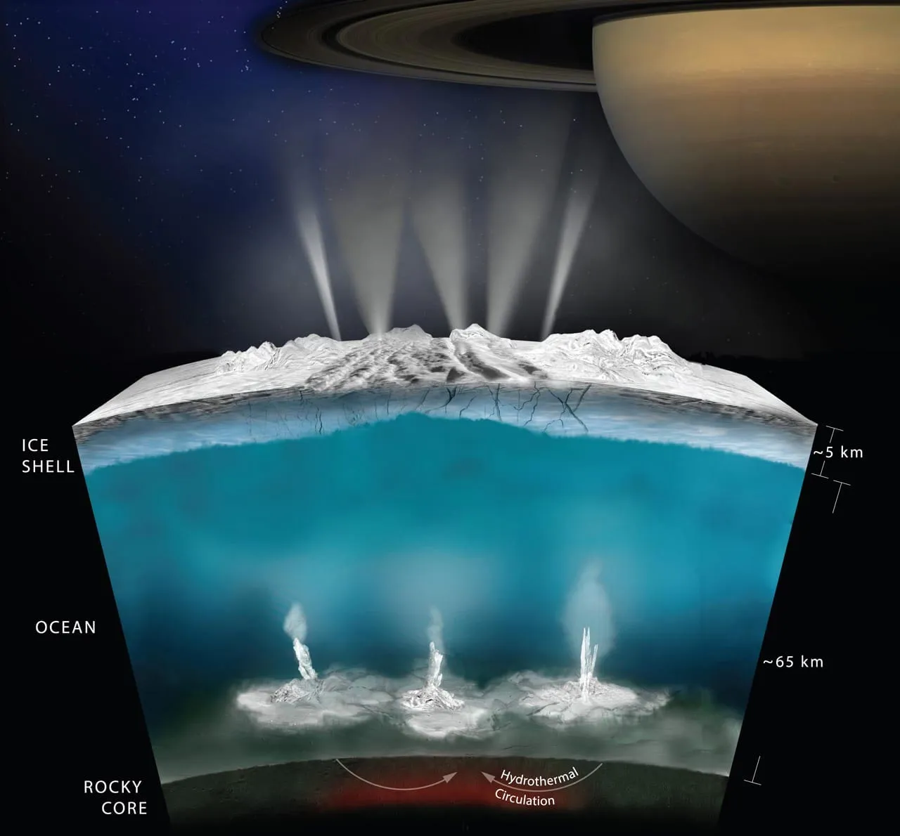
Science Motivation
Landing on the South Pole of Enceladus, sampling the Enceladus plumes and allowing for science around Titan and other moons have been rated at the top of the scientific priorities for the mission.
Credit: NASA/JPL

Slide 17
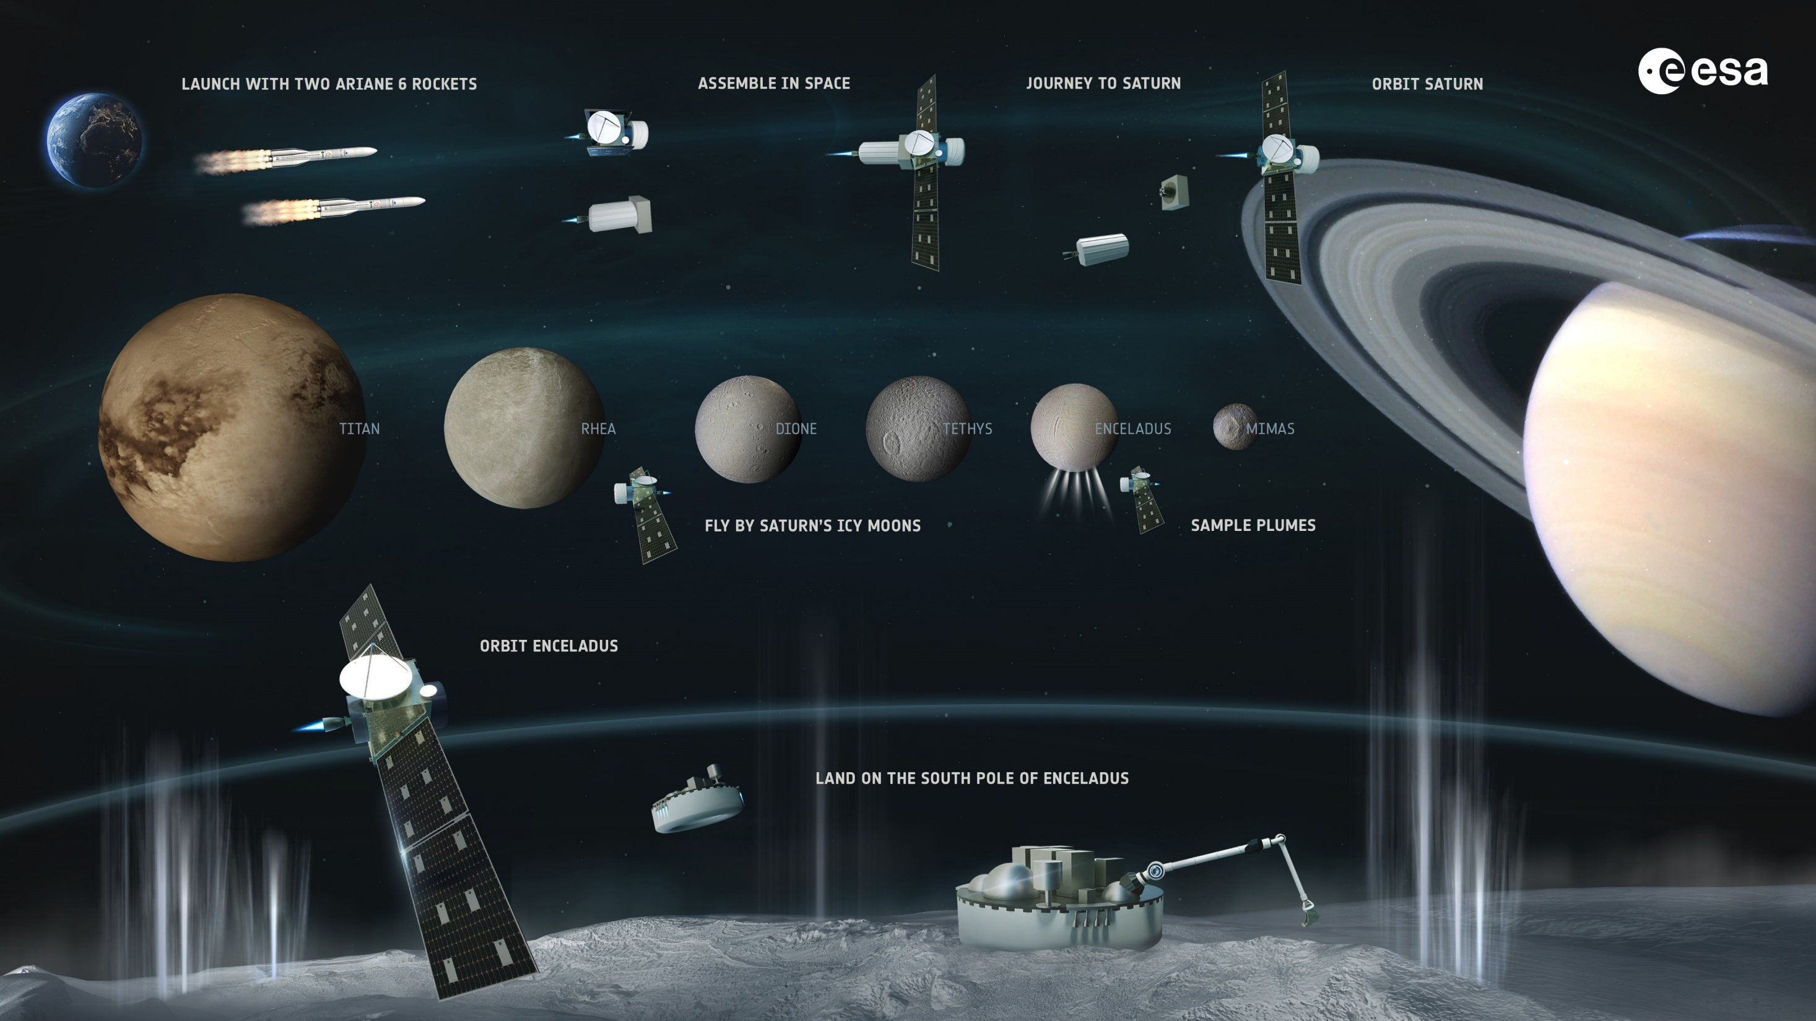

Slide 18
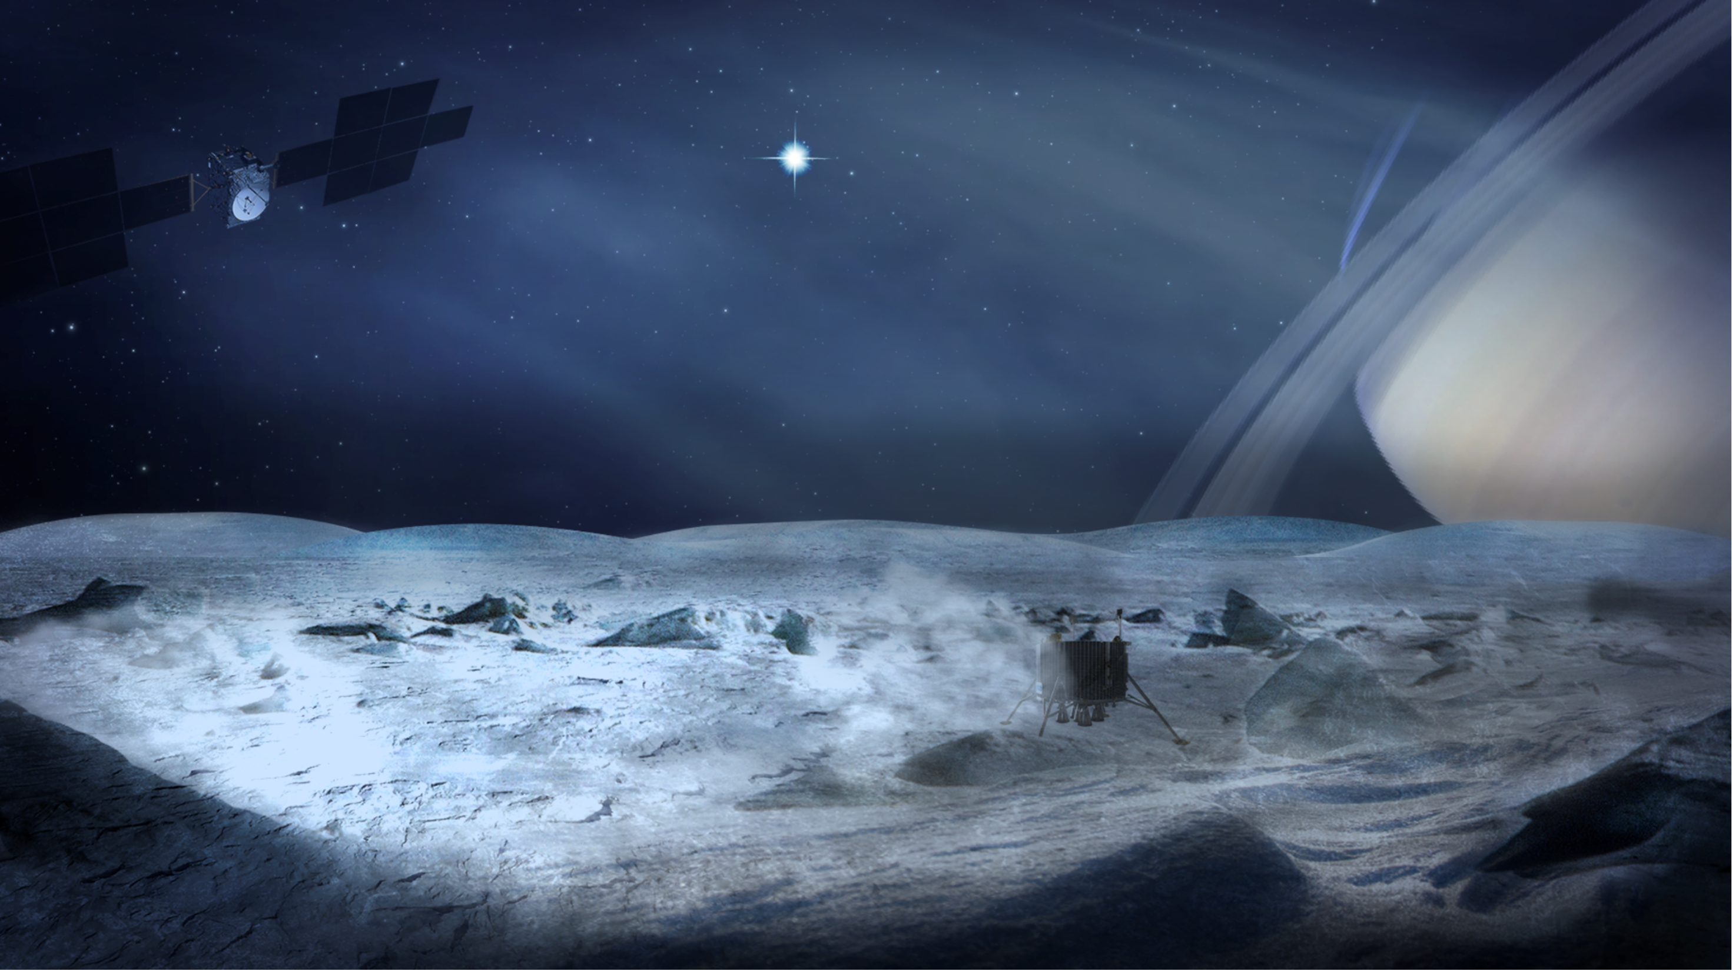
L4 Moons of the Giant Planets It will be cold, dark and far far away from home
9 years transfer time
10 AU distance to earth 80 minutes at light speed
~1% Solar Irradiance (ref Earth)
Enceladus surface temperature as low as 60 -180 Kelvin

Slide 19
L4: Establishing Technology Needs and Building Blocks
Propulsion
Systems
Large
Solar Arrays
RHU
Coms RF and Optical
Energy Efficiency
Energy Generation
Fuel Cells
Cryogenic
Electronics
Astrobiology Instruments
Reliability
Cryogenic sample handling mechanisms
Modelling & Tools
Thermal Management
Energy Storage
Autonomous Landing Technologies
In-Orbit Rendezvous
Primary Battery
Systems
Secondary Battery
Systems

Slide 20
L4 Technology Development Timeline
With a launch target in 2043, the L4 mission adoption would be around 2034.
To derisk the implementation phase all critical technologies should be under active and advanced development and reach sufficient technological maturity at adoption.
This leaves less than 10 years for the pre-development phase.
2024
2034
~Oct 2043
First Industrial studies
Phase0
PhaseA
PhaseB1
Now
MDR
MCR
MFR
MAR
Adoption
Launch

Slide 21
L4: A Components Challenge 1 - Warm or Cold ?
Maximising Science Time and instrumentation on the Enceladus surface is the main objective for the mission
Considering our energy limitations there are two operation philosophies
Surface Temperature:
60 - 180 Kelvin
Operate Orbiter/Lander “warm”
maintaining temperature qualification
range of all components
Operate Orbiter/Lander “cold”
At the lowest (physically) possible temperature of components
For components selection low risk and broad choice
However significant energy for heaters required
Also, potentially more resources (mass/vol) for thermal isolation might be required
What are the physical limitations of components regarding Non-Op, Start-Up and operation temperatures?
Reduced components choice and higher risk
Dedicated tests and developments required

Slide 22
L4: A Components Challenge 2 – Energy Harvesting
Lander will rely on its battery for core science phase (CSP) - goal is 30 days - in continuous operation mode
Carry out primary science experiments
Idea to significantly extended science phase (ESP) by harvesting and storing small amounts energy while switching to an intermediate and low power operation mode
Carry out additional science experiments when enough energy has been collected for the experiment and the data transmission

Slide 23
L4: The Components Challenge 2 – Energy Harvesting
Required Technology Building Blocks
Energy Sources
High Efficiency Energy Storage
Lander Solar Panels, raised or body mounted
Beta-voltaic batteries
Remote Power Transfer from Orbiter (RF/Optical)
Ultra/Super Capacitors
Classical batteries
Superconducting Magnetic Energy Storage (doubtful)
High Efficiency Sensors, Coms and Processing
Optical Coms, low power RF (VHF etc)
Actuated Retroreflectors
Key challenge:
even less energy available for heating and lander will be even colder and further cooling down during this phase. Potential use of Radioisotope heaters to maintain some minimum temperature.

Slide 24
ESA Science – pushing technology to explore the Universe
Credit: Cassini, NASA/JPL/Space Science Institute

